Slide 1
Software Construction and Development
Week 14
Instructor :M Khizar Hayat
Performance Optimization and Code Efficiency
Chapter 13 Clean Code

Slide 2
Introduction to Performance Optimization
Performance optimization is the process of improving software so it executes tasks faster, consumes fewer resources, and provides a better user experience.
Objectives
Reduce execution time
Minimize memory consumption
Improve responsiveness
Increase scalability

Slide 3
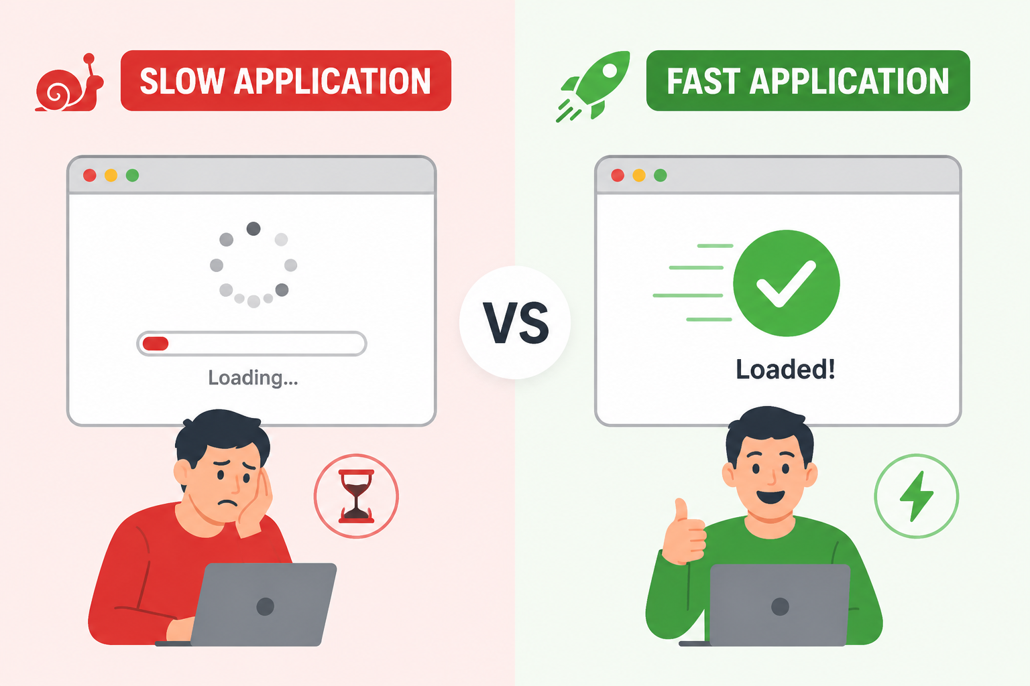
Benefits
Faster applications
Better customer satisfaction
Lower infrastructure costs
Efficient use of hardware resources

Slide 4
Factors Affecting Performance
Algorithm Efficiency
The choice of algorithm significantly affects execution speed.
Memory Usage
Excessive memory usage can slow down applications.
CPU Utilization
High CPU consumption may reduce overall system performance.
Disk and Network I/O
Frequent reading/writing operations increase response time.
Concurrency Management
Improper thread management can create bottlenecks.

Slide 5
Performance Formula
Performance = Work Done / Time Taken
Example 1
Suppose a program processes 1000 records in 10 seconds.
Performance= 1000/10 =100
Result: The program processes 100 records per second.
Example 2 (After Optimization)
The same program now processes 1000 records in 5 seconds.
Performance= 1000/5 = 200
Result: The program processes 200 records per second.

Slide 6
Code Optimization Techniques
Eliminate Dead Code
Avoid Repeated Work
Use Efficient Data Structures
Cache Results
Minimize Object Creation
Loop Optimization

Slide 7
Eliminate Dead Code
Dead code is code that never executes or whose result is never used. Removing it reduces code size and improves readability.
Example:
public class DeadCodeExample {
public static void main(String[] args) {
int age = 20;
// Dead code: never executes
if(false){
System.out.println("Never Executes");
}
System.out.println("Age = " + age);
}
}

Slide 8
After Eliminating Dead Code(Optimized Version)
public class DeadCodeExample {
public static void main(String[] args) {
int age = 20;
// Unnecessary code removed
System.out.println("Age = " + age);
}
}
Benefit: Cleaner and more maintainable code.

Slide 9
Avoid Repeated Work
Avoid performing the same calculation repeatedly
Example:
public class RepeatedWorkExample {
public static void main(String[] args) {
double radius = 5;
for(int i = 0; i < 1000; i++) {
// Same calculation performed 1000 times
double area = Math.PI * radius * radius;
System.out.println(area);
}
} }

Slide 10
Optimized Version
public class RepeatedWorkExample {
public static void main(String[] args) {
double radius = 5;
// Calculate once
double area = Math.PI * radius * radius;
for(int i = 0; i < 1000; i++) {
// Reuse calculated value
System.out.println(area);
}
} }
Benefit: Reduces CPU usage.

Slide 11
Use Efficient Data Structures
Select the data structure best suited for the operation.
Example:
import java.util.ArrayList;
import java.util.List;
public class DataStructureExample {
public static void main(String[] args) {
// Searching in ArrayList can be slower
List<String> names = new ArrayList<>();
names.add("Ali");
names.add("Ahmed");
names.add("Sara");
if(names.contains("Ali")) {
System.out.println("Found");
} } }

Slide 12
Optimized Version
import java.util.HashSet;
import java.util.Set;
public class DataStructureExample {
public static void main(String[] args) {
// HashSet provides faster lookups
Set<String> names = new HashSet<>();
names.add("Ali");
names.add("Ahmed");
names.add("Sara");
if(names.contains("Ali")) {
System.out.println("Found");
}
}
}
Benefit: Faster search performance.

Slide 13
Cache Results
Store previously computed values for reuse.
Example:
public class CacheExample {
// Calculates square every time method is called
public static int getSquare(int n) {
return n * n;
}
public static void main(String[] args) {
System.out.println(getSquare(5));
System.out.println(getSquare(5));
System.out.println(getSquare(5));
}
}

Slide 14
Optimized Version
import java.util.HashMap;
import java.util.Map;
public class CacheExample {
static Map<Integer,Integer> cache = new HashMap<>();
public static int getSquare(int n) {
// Calculate only if result not already stored
if(!cache.containsKey(n)) {
cache.put(n, n * n);
}
// Return cached value
return cache.get(n);
}
public static void main(String[] args) {
System.out.println(getSquare(5));
System.out.println(getSquare(5));
System.out.println(getSquare(5));
}}
Benefit: Avoids repeated computations.

Slide 15
Minimize Object Creation
Reduce unnecessary object creation.
Example:
public class ObjectCreationExample {
public static void main(String[] args) {
for(int i = 0; i < 1000; i++) {
// New object created each iteration
String message = new String("Hello");
System.out.println(message);
}
}
}

Slide 16
Optimized Version
public class ObjectCreationExample {
public static void main(String[] args) {
// Single object reused
String message = "Hello";
for(int i = 0; i < 1000; i++) {
System.out.println(message);
}
}
}
Benefit: Reduces memory allocation and garbage collection.

Slide 17
Loop Optimization
Avoid unnecessary operations inside loops.
Example:
import java.util.ArrayList;
import java.util.List;
public class LoopOptimizationExample {
public static void main(String[] args) {
List<String> list = new ArrayList<>();
list.add("Java");
list.add("Python");
list.add("C++");
for(int i = 0; i < list.size(); i++) {
// size() called every iteration
System.out.println(list.get(i));
} } }

Slide 18
Optimized Version
import java.util.ArrayList;
import java.util.List;
public class LoopOptimizationExample {
public static void main(String[] args) {
List<String> list = new ArrayList<>();
list.add("Java");
list.add("Python");
list.add("C++");
// Store size once
int size = list.size();
for(int i = 0; i < size; i++) {
// Reuse stored value
System.out.println(list.get(i));
}
} }
Benefit: Improves loop efficiency, especially for large collections.

Slide 19
Memory Management
Managing memory allocation and deallocation efficiently
Goals:
Reduce memory consumption
Prevent memory leaks
Improve application stability

Slide 20
Memory Leak Example
Problem
List<String> data = new ArrayList<>();
while(true){
data.add("test");
}
Memory keeps growing.
Solution
data.clear();
or
data = null;

Slide 21
Garbage Collection
Automatic removal of unused objects from memory
Example
Student s = new Student();
s = null;
Object becomes eligible for garbage collection
Benefits
Automatic cleanup
Better memory usage

Slide 22
Performance Profiling
Purpose
Identify bottlenecks in applications
Measures
CPU Usage
Memory Usage
Execution Time
Thread Activity

Slide 23
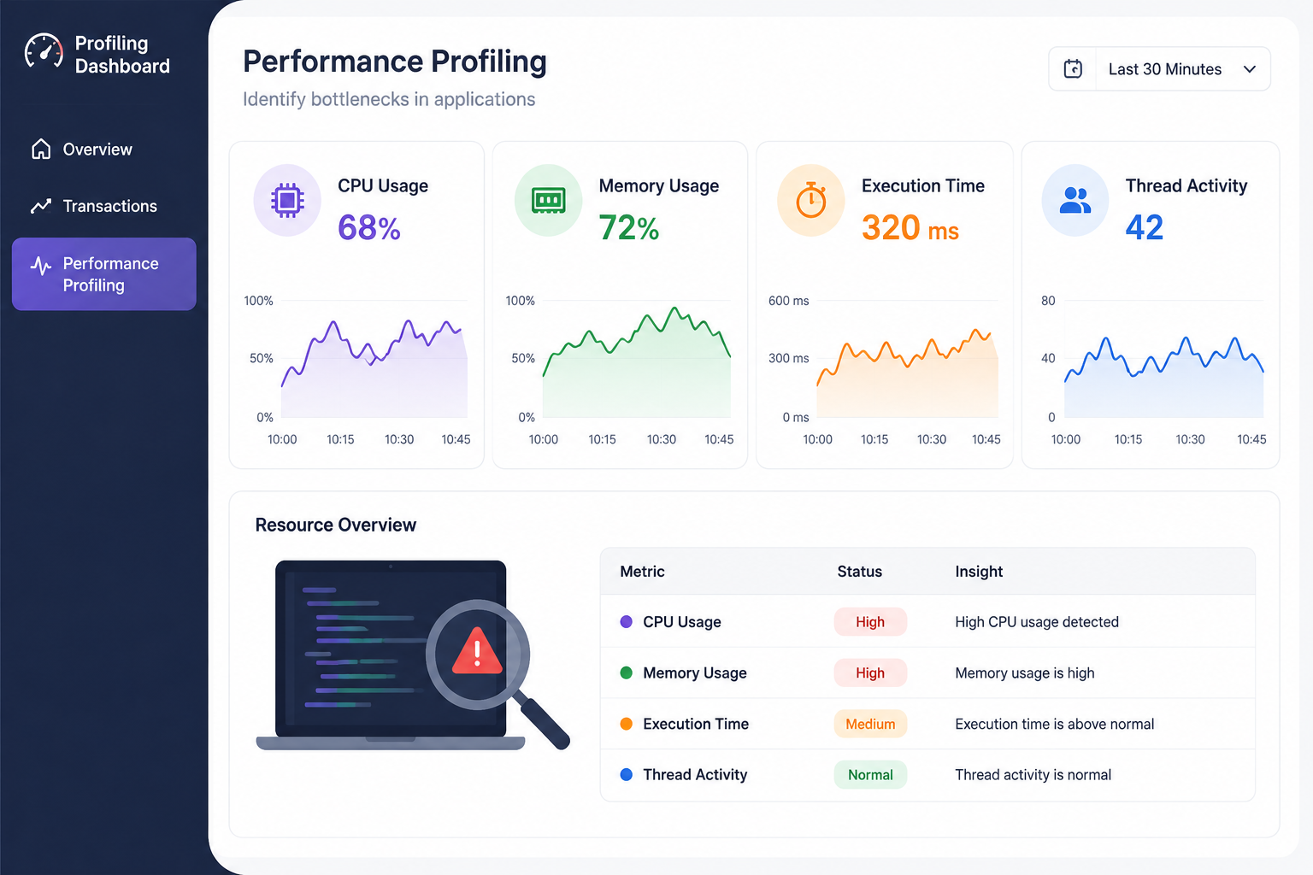

Slide 24
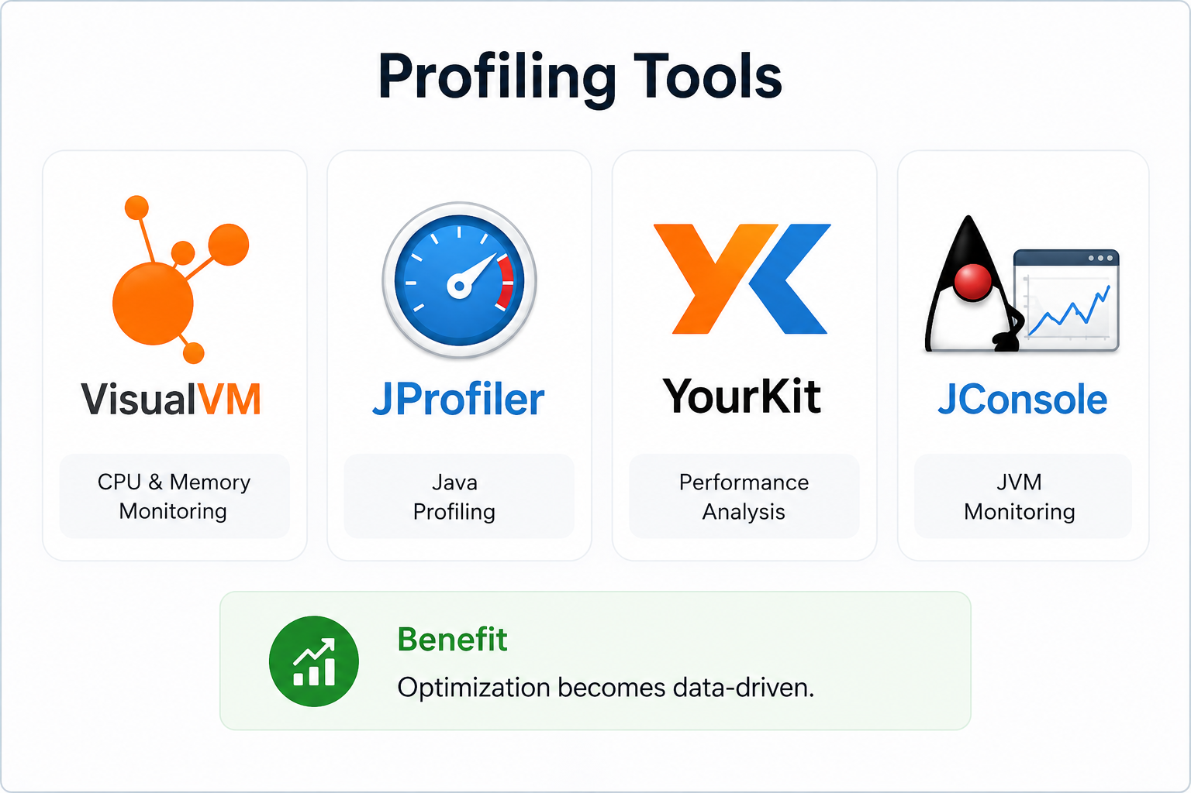
Profiling Tools

Slide 25
Multi-threading
Executing multiple tasks simultaneously.
Example
Thread t1=new Thread(() -> task1());
Thread t2=new Thread(() -> task2());
t1.start();
t2.start();
Benefits
Faster execution
Better responsiveness

Slide 26
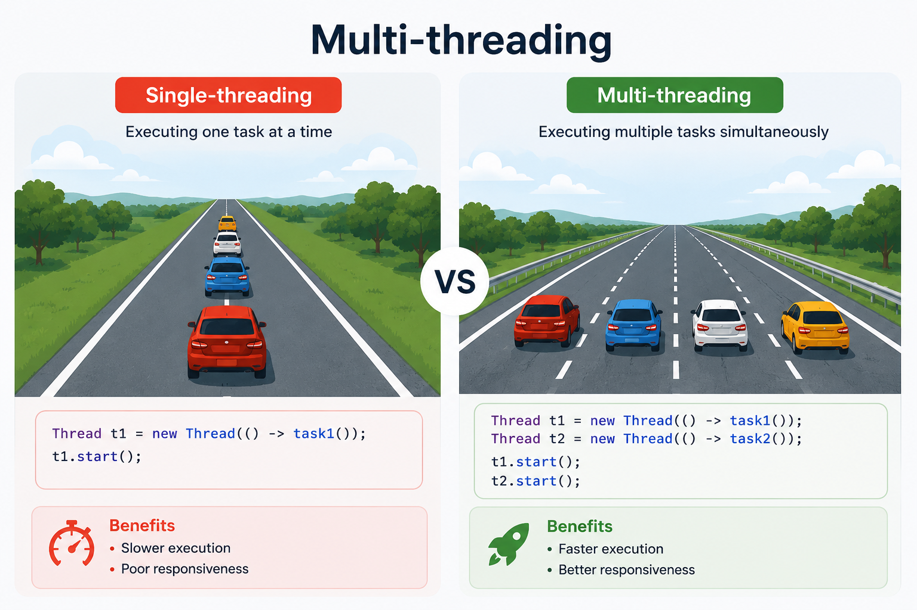

Slide 27
Concurrency Challenges
Common Issues
Race Condition
Deadlock
Starvation
Example
count++;
Multiple threads may update simultaneously.

Slide 28
Synchronization Example
Without Synchronization
count++;
May produce incorrect results
With Synchronization
synchronized(lock){
count++;
}
Result: Ensures thread safety

Slide 29
Conclusion & Best Practices
✔ Use efficient algorithms
✔ Select appropriate data structures
✔ Manage memory carefully
✔ Profile before optimizing
✔ Use multi-threading wisely
✔ Handle concurrency safely

Slide 30
Quote
"Premature optimization is the root of all evil." — Donald Knuth
Thank You!

